Slide 1

Object Classiﬁcation and Counting with Count-ception Network
Supervisor: Giacomo Boracchi
Co-supervisor: Diego Carrera
Author: Zhou Yinan

Slide 2
Index
Problem Formation
A Baseline Approach
Modified Count-ception Network
Conclusion and Improvements

Slide 3
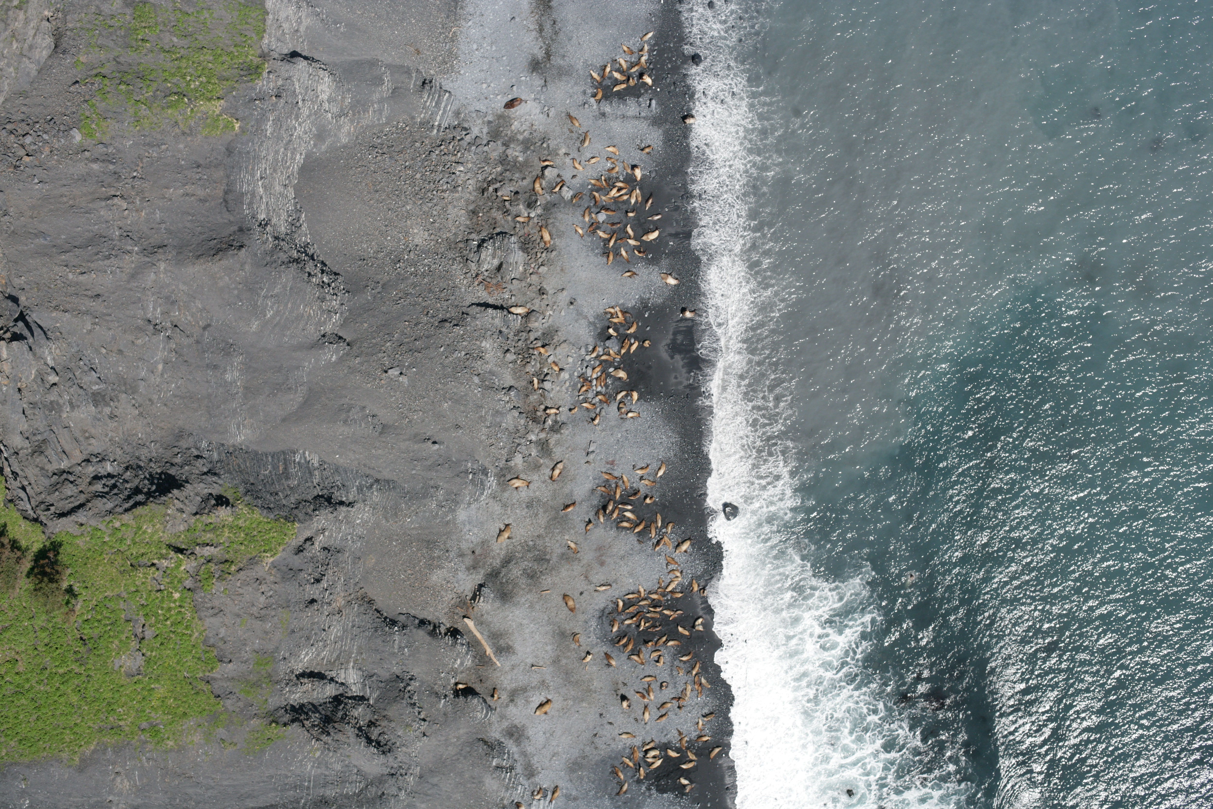
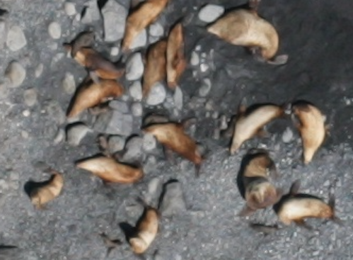
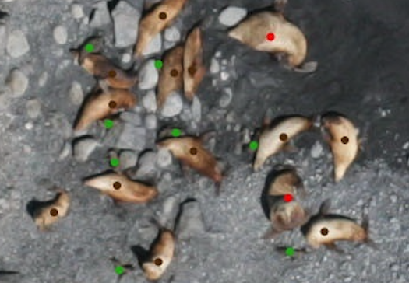
Estimate the number of different types of sea lions
adult males = 9
subadult males = 5
adult females = 76
juveniles = 4
pups = 51
original image
947 images
high resolution: 4K x 3K , 6 MB
little training info
dot label image

Slide 4
Challenges
Tiny similar objects in complex backgrounds
Not so much training info provided, only center dots in the object
High resolution images causing memory issue
Unbalanced sea lion type distribution

Slide 5
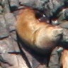
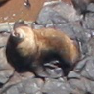
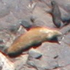
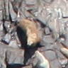
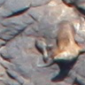
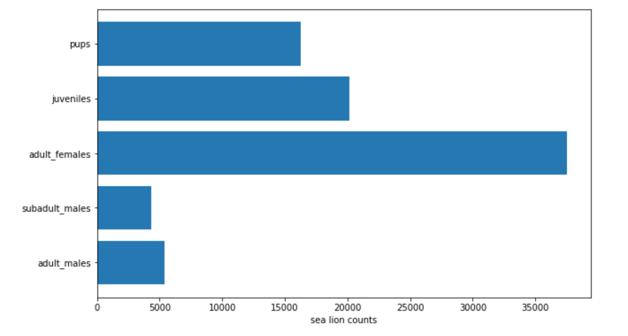
Challenges
adult males
subadult males
adult females
juveniles
pups
unbalanced sea lion type distribution
sparse object distribution

Slide 6
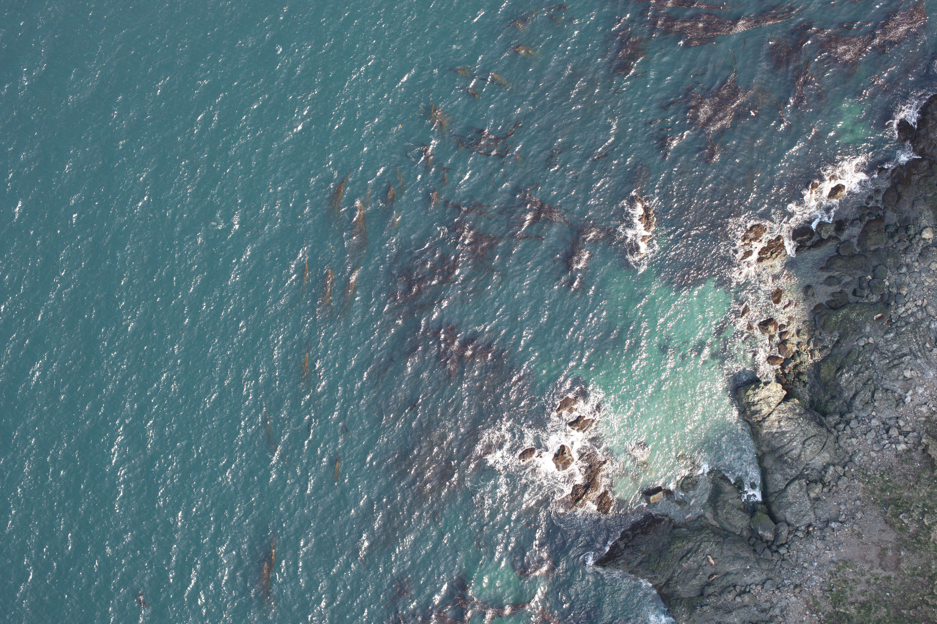
adult males = 2
subadult males = 4
adult females = 0
juveniles = 0
pups = 0
size: 8.4 MB
dimension: 5616 x 3744

Slide 7
Problem Formation
Scenario: five types of sea lions in high resolution images
Goal: estimate the number of each type of sea lion in testing images
Thesis: object classification + object counting with deep learning architecture
Usage: automate preliminary information gathering for various researches, for example endangered animal protection, biological imaging analysis...

Slide 8
Index
Background and Problem Formation
A Baseline Approach
Modified Count-ception Network
Conclusion and Improvements

Slide 9
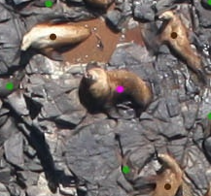
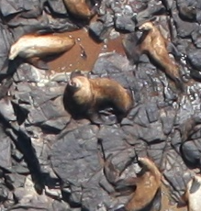
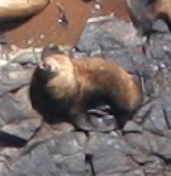
A Baseline Approach
Patch extraction and classification with convolutional neural network (CNN)
Dataset Construction
Blob detection to get color dot coordinates
Patch extraction from original images
(223, 2560)
96
96
dot label image
dot label image

Slide 10
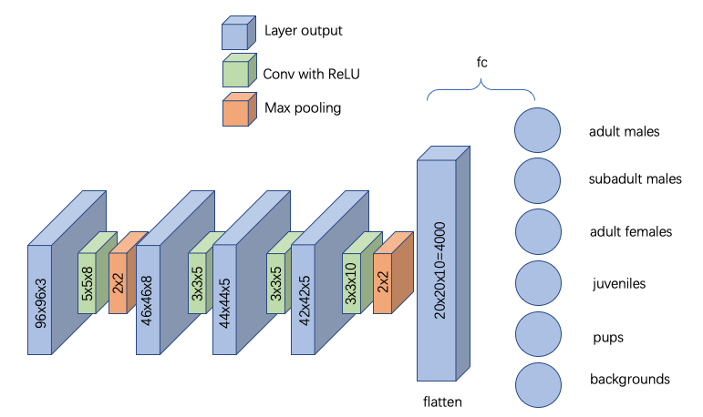
A Baseline Approach
Train CNN for patch classification
Inference:
separate whole image into patches
classify each patch with trained CNN
summarize the result for final counting estimate
50% accuracy

Slide 11
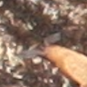
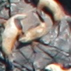
A Baseline Approach
sea lion types | adult males | subadult males | adult females | juveniles | pups
avg count error | 25.77 | 40.98 | 7.53 | 199.75 | 314.83
Issues
Assume each sea lion lies in the center
Assume each patch contains at most one sea lion
sea lion at corner
sea lion chopped
three sea lions in one
patch

Slide 12
Index
Problem Formation
A Baseline Approach
Modified Count-ception Network
Conclusion and Improvements

Slide 13
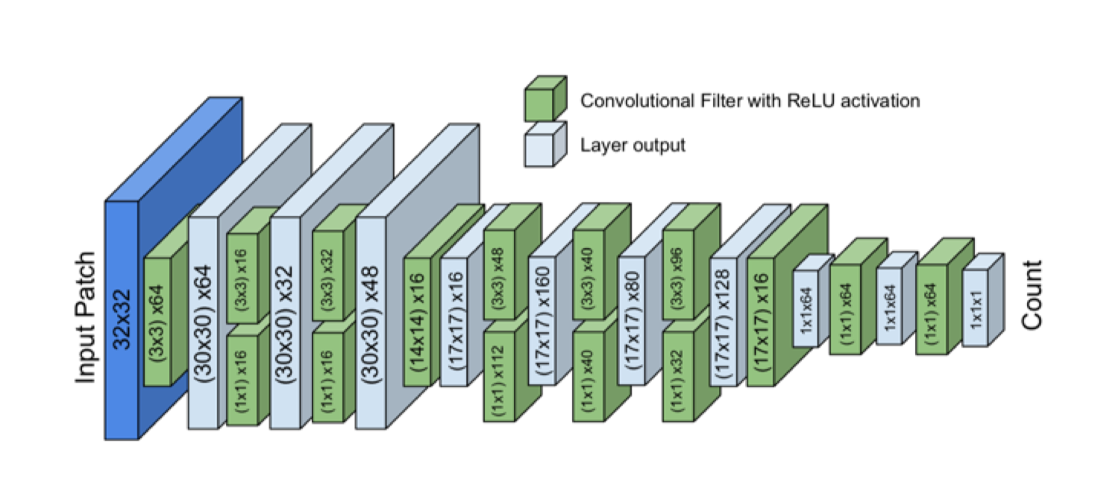
Count-ception Network
[1]
regression network
fully convolutional network
optimized for object counting
[1] Joseph Paul Cohen, Henry Z. Lo, and Yoshua Bengio. Count-ception:
Counting by fully convolutional redundant counting. CoRR, abs/1703.08710, 2017.

Slide 14
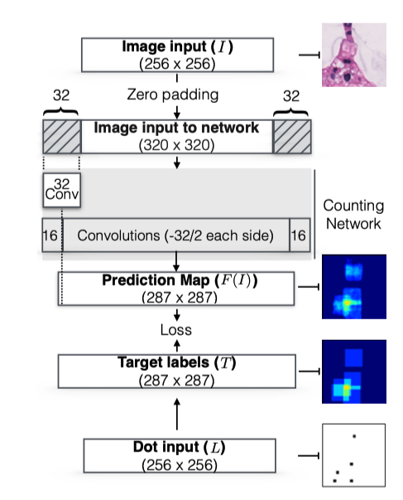
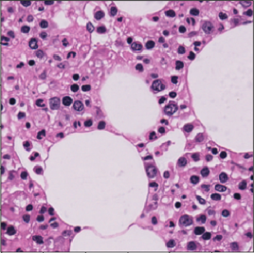
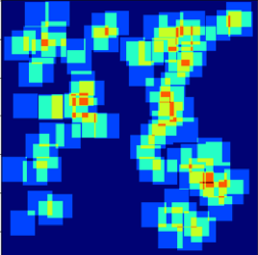
Count-ception Network
cell image
256 x 256
loss
heat map

Slide 15
Count-ception Network
32
1
1
32

Slide 16
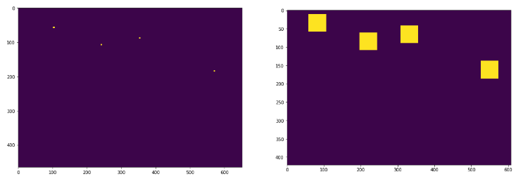
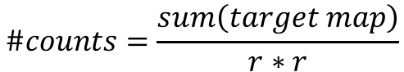
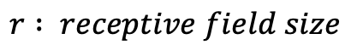
Count-ception Network
Target map construction
redundant counting
dot label image
target heat map
$$\#counts=\frac{sum\left(target map\right)}{r∗r}$$
convolution
$$r : receptive field size$$

Slide 17
Modified Count-ception Network
Change convolution filters at the last layer
add classification functionality
Insert weight balance layer
deal with sparse object distribution
deal with non-uniform sea lion type distribution
Increase receptive field size
from 32x32 to 96x96
big enough to cover each sea lion type

Slide 18
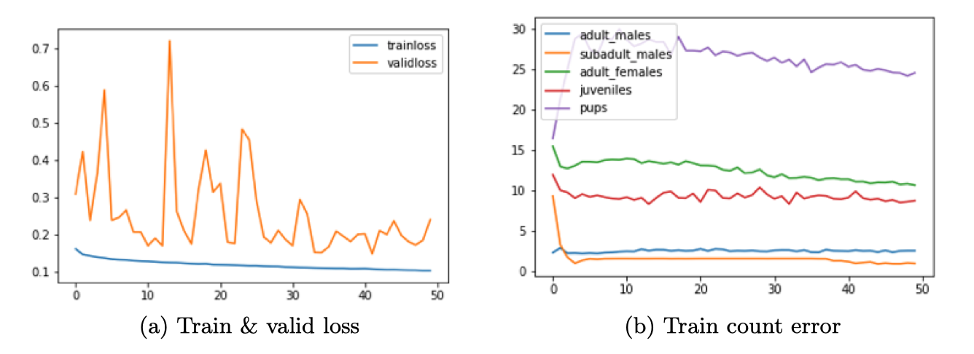
Modified Count-ception Network
sea lion types | adult males | subadult males | adult females | juveniles | pups
Count-ception count error | 47.0 | 6.3 | 40.0 | 21.3 | 35.8
baseline count error | 25.77 | 40.98 | 7.53 | 199.75 | 314.82

Slide 19
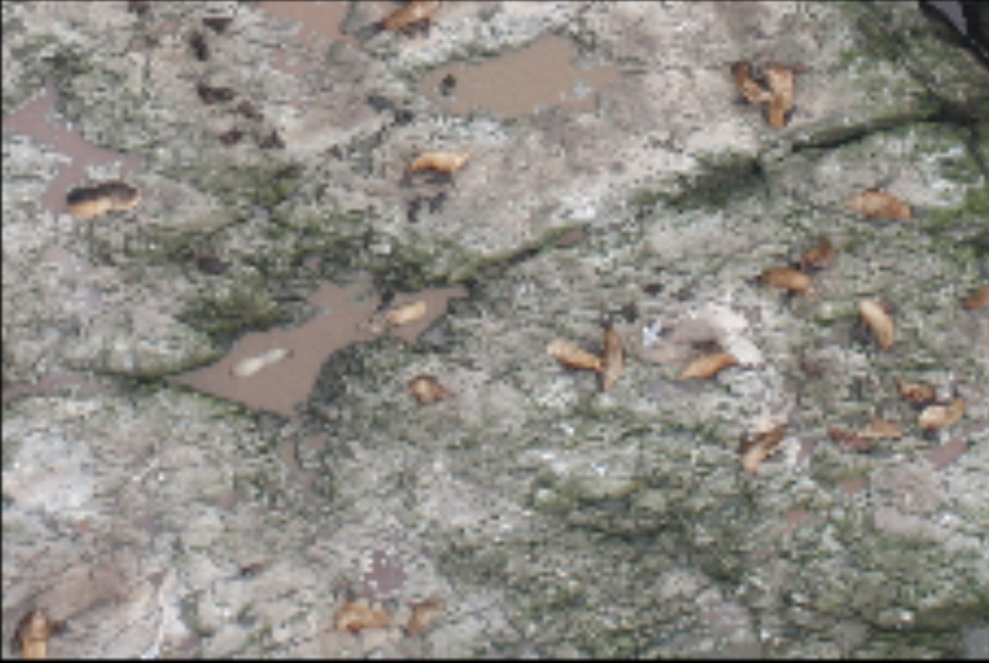
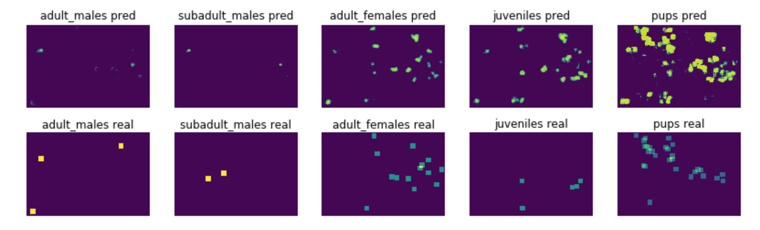
Modified Count-ception Network
False positive is an issue
from rocks
from other types of sea lions

Slide 20
Index
Problem Formation
A Baseline Approach
Modified Count-ception Network
Conclusion and Improvements

Slide 21
Conclusions: our contribution
Modified Count-ception network outperforms baseline approach
Train the network in fully convolutional manner has the following benefits:
able to do training with few training data
able to deal with sparse heatmaps when weight balance layer is used
suits for counting objects which are close to each other
a lot faster than the equivalent batch-wise training
Complex backgrounds and false positives
Memory consumption is an issue

Slide 22
Challenge Solutions
Tiny similar objects in complex backgrounds
inherent difficulty
Not so much training info provided, only center dots in the object
train the network in fully convolutional manner
implicitly create highly overlapping patches in mini-batch
High resolution images causing memory issue
each image is separated into 25 parts
Unbalanced sea lion type distribution
weight balance layer

Slide 23
Further Improvements
High GPU memory to avoid image separation
More complex Count-ception architecture
Spatial correlation in heat maps

Slide 24
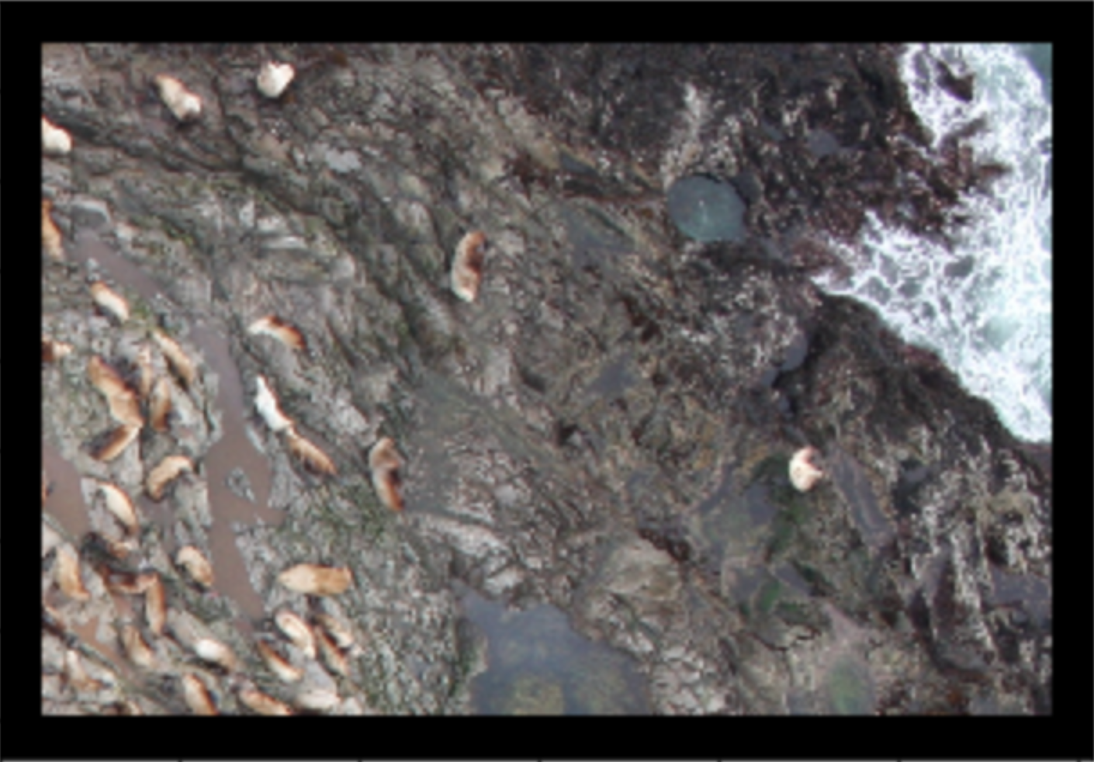
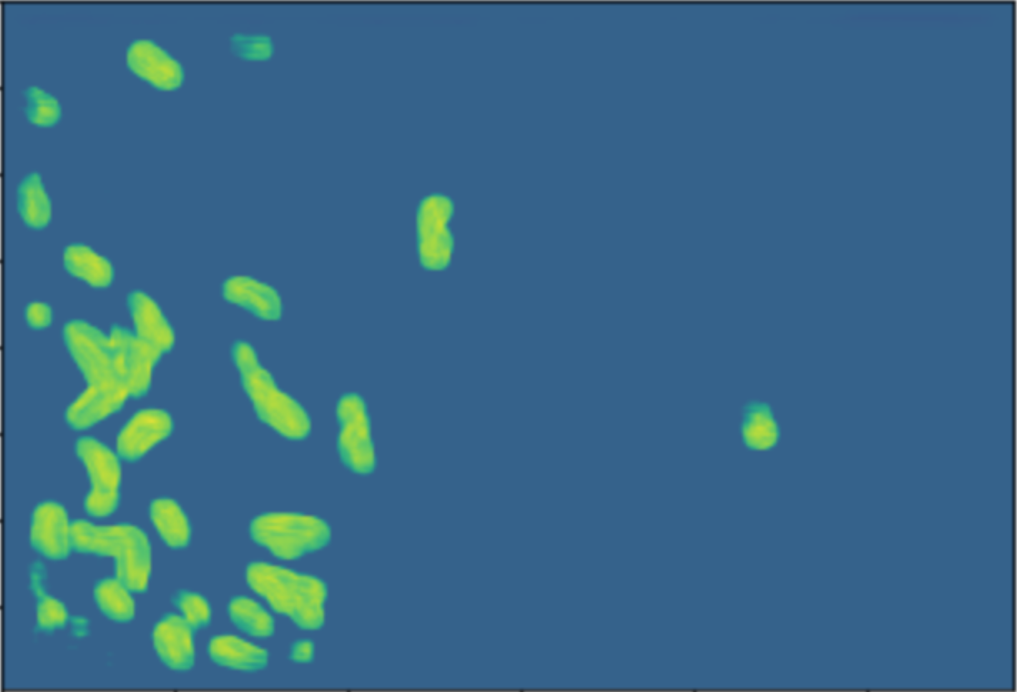
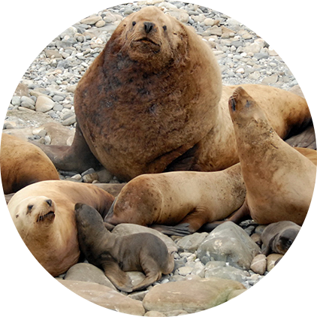
Sealion detection
Thanks
Q & A

Slide 25
Supplement Slides

Slide 26

Background
Image classification

Slide 27

Background
Image classification

Slide 28
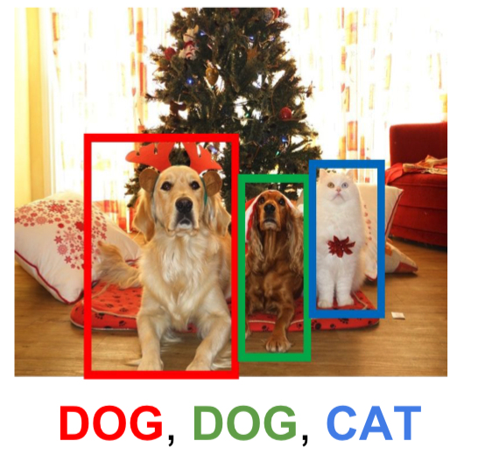
Background
Object detection
Multi-objects in image
Bounding box to locate objects
Our problem
Focus on multi-object counting

Slide 29
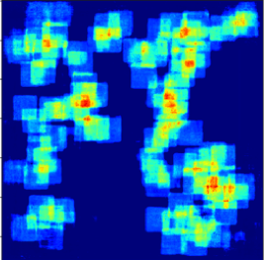
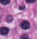
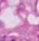

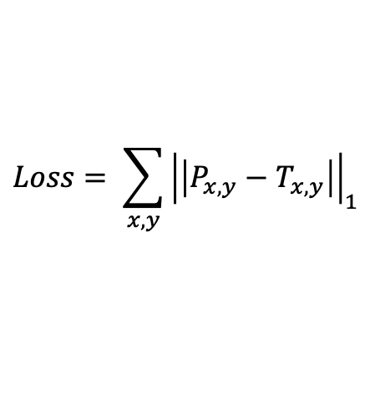
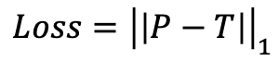
Train Fully Convolutionally
prediction
target
original image
loss
...
$$Loss={\left|\left|P−T\right|\right|}_{1}$$
...
$$Loss= \sum_{x,y}{{\left|\left|P_{x,y}−T_{x,y}\right|\right|}_{1}}$$
mini-batch

Slide 30
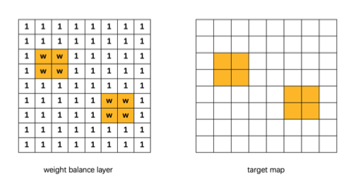
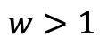
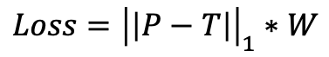
Weight Balance Layer
$$w>1$$
$$Loss={\left|\left|P−T\right|\right|}_{1}∗W$$

